Slide 1
Acute and chronic otitis externa
Done By: Yacoub Zayadin

Slide 2
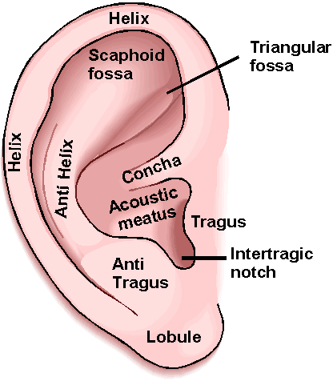
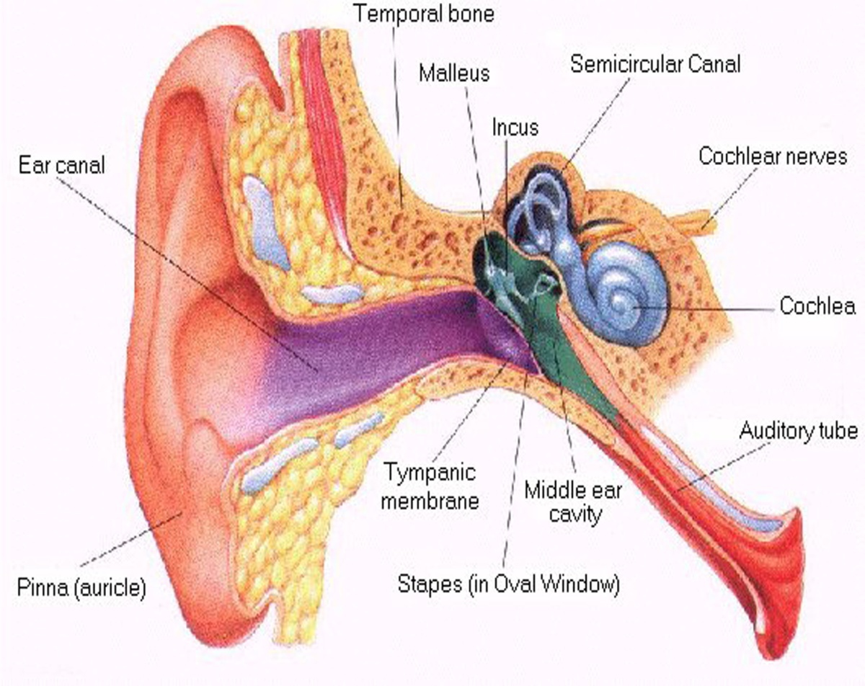
Anatomy of the outer ear

Slide 3
The external ear consists of two parts: the outer cartilaginous pinna, and the external auditory meatus.
The external ear serves the function of collecting sound vibrations and transmitting them through the external auditory meatus towards the tympanic membrane.

Slide 4
Impacted Wax
It is collection of wax in the external auditory meatus. New wax is light brown in color while old wax is dark brown to black in color.
If asymptomatic no need for treatment.
Symptoms: 1. Conductive weakness
2.Tinnitus
3. Vertigo.
4. Pain or Itching
5. Cough
Before managing impacted wax we should rule out Tympanic membrane perforation and acute suppurative otitis media.

Slide 5
Risk Factors: 1. Cleaning the ear with cotton bud
2. Usage of hearing aid.
Management:
First the wax needs to softened by olive oil for two days.
Usage of vacuum or curette to remove impacted wax.
Prevention: the best way to prevent impacted wax is not to use a cotton bud or any other objects to clean the ear. Patients with hearing aids should have their ears checked routinely.

Slide 6
Otitis Externa
Otitis externa is a condition that causes inflammation of the external ear.
Otitis externa is sometimes called ‘swimmer's ear’ or ‘tropical ear’. This is because it can sometimes be caused by getting water inside your ear canal and it is often more common in humid conditions.
Divided into: 1. Localized otitis externa
2. Acute diffuse otitis externa
3. Chronic otitis externa

Slide 7
Localized Otitis Externa (furunculosis)
Localized otitis externa (furunculosis) is an infection of a hair follicle in your ear canal. Caused by Staphylococcus aureus.
Symptoms:
A small red pimple in your ear canal which may have white or yellow pus at its centre.
Severe ear pain (particularly when you move your ear). The pain may seem out of proportion to the size of the pimple and, in rare cases, the pimple or boil bursts, causing the pain to stop suddenly.
Occasional hearing loss, which can occur if the pimple or boil is obstructing your ear canal.
Post-auricular lymph nodes enlargement.

Slide 8
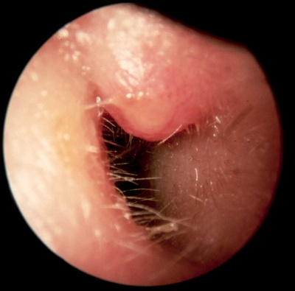

Slide 9
Treatment
Furunculosis may heal on its own in some cases so only analgesics are used for the first week.
If symptoms persist for more than one week oral antibiotics are used (Flucloxacillin).
If still symptoms persists it may need surgical incision and drainage.
If left untreated the pimple may turn into a boil obstructing the external auditory meatus and may also rupture, drain and heal by itself causing a lot of pain and discomfort along the way.

Slide 10
Acute Diffuse Otitis Externa
Acute diffuse otitis externa is a more widespread inflammation of the ear canal, which causes a skin rash that can extend to the pinna and the tympanic membrane.
Acute diffuse otitis externa is the most common form of otitis externa.
Otitis externa is defined as acute if it lasts for less than three weeks.

Slide 11
Symptoms:
Otalgia
Hearing loss
Itching
Discharge
Painful redness and swelling of the pinna
Cervical lymphadenopathy
Causes:
Bacterial
Fungal
Viral

Slide 12
Risk Factors
External Ear Damage
Excessive Moisture
Chemicals
Underlying Skin Condition
Allergic Conditions
Immune Suppression

Slide 13
Bacterial Acute Otitis Externa
Usually caused by:
1. Pseudomonas aeruginosa
2. Staph. aureus
3. E. Coli
Signs:
1. Erythema
2. Edema
3. Narrowing of the canal
4. Discharge
Treatment:
1. Local and oral antibiotics
2. Analgesic

Slide 14
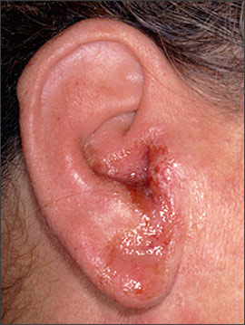
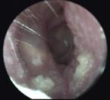

Slide 15
Fungal Acute Otitis Externa
Also called Otomycosis
Usually caused by:
1. Aspergillosis (black)
2. Candidiasis (white)
Risk Factors:
1. Immune suppression
2. Swimming
3. Secondary to bacterial infection
4. Long term usage of antibiotic eardrops or topical steroids
Usually painless and very itchy.
Treatment: 1. Cleaning
2. Topical antifungal

Slide 16
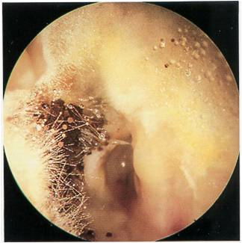
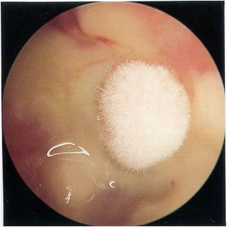
Aspergillus Candida
black white

Slide 17
Viral Acute Otitis Externa
Ramsay Hunt Syndrome: it is a painful vesicular skin rash caused by the varicella zoster virus. The virus is believed to infect the facial nerve near the inner ear.
Symptoms:
1. Severe otalgia with painful vesicular rash
2. Sensorineural unilateral hearing loss
3. Vertigo
4. Facial Palsy
Treatment: 1. Steroids
2. Antivirals (acyclovir)
3. Protection of the cornea (Eye patch)

Slide 18
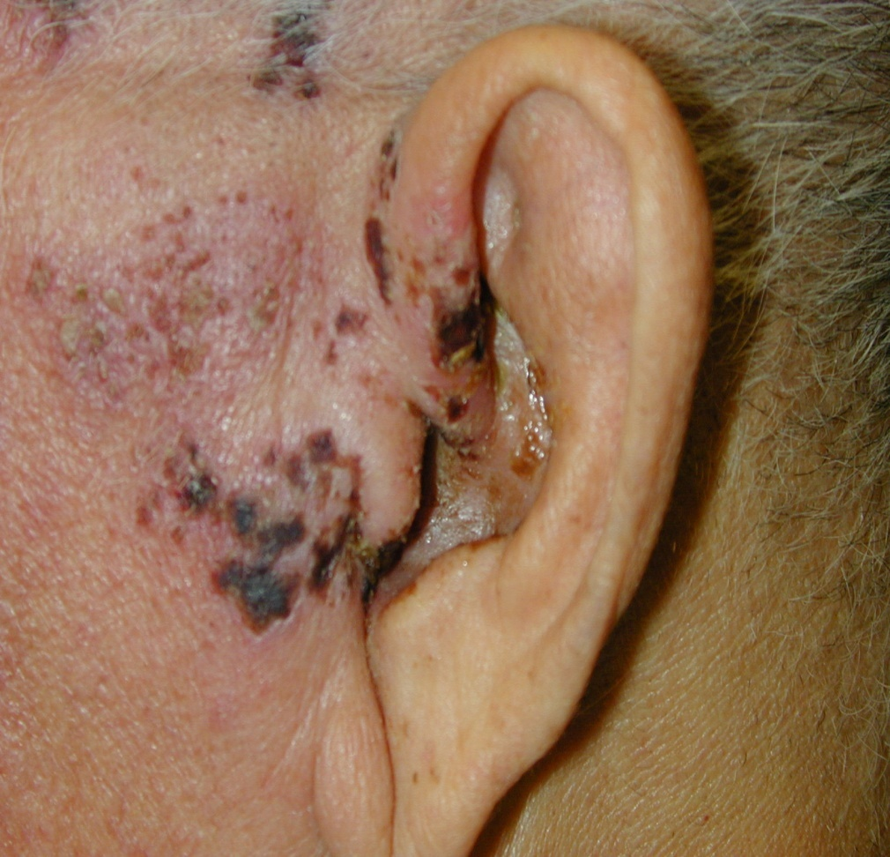

Slide 19
Complications of Otitis Externa
Abscess
Stenosis of the ear canal
Perforated tympanic membrane
Cellulites
Malignant Otitis Externa: it is a rare but serious complication, in which the infection spreads to the bone that surrounds the ear canal. Usually affects immune compromised patients. If left untreated can cause mortality and should be treated directly with antibiotics and surgery to remove damaged tissue.

Slide 20
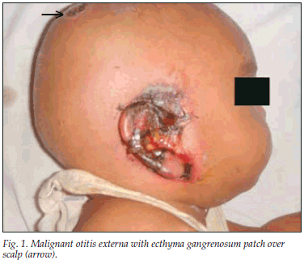
Malignant Otitis Externa

Slide 21
Chronic Otitis Externa
Otitis Externa is defined as chronic when then duration of infection lasts for more than 4 weeks.
Symptoms: 1. Pruritis
2. Pain or discomfort
3. Thin, watery discharge
4. Stenosis
Causes of Chronic otitis externa are similar to acute. However in many cases the cause is unknown.
Treatment: much like acute otitis externa with the addition of steroid ear drops.

Slide 22
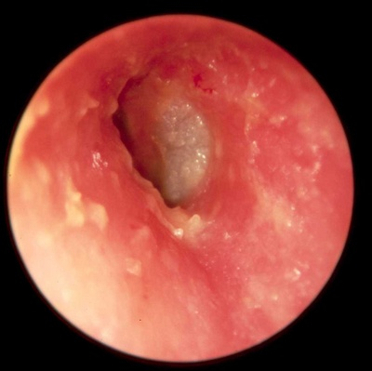

Slide 23
THANK YOU

